Slide 1
The deal's the limit:
When and why restricted promotions work
David J. Hardisty
Presented at Baruch College Nov 21, 2024

Slide 2
Two papers in one talk. Folly?
Du, G. & Hardisty, D. J. (2024). When Do Purchase Precondition Promotions Work? The Role of External Reference Points. Working paper.
Yi, S., Hardisty, D. J., Griffin, D. W., & Allard, T. (2024). Promotion Architecture: The Perceived Fairness of Restricted Price Promotions. Working paper.

Slide 3
When Do Purchase Precondition Promotions Work?
The Role of External Reference Points
The Knowledge, Information and Innovation Research Group
Guanzhong Du David Hardisty
Funded by

Slide 4

Guanzhong Du

Slide 5
Imagine that you are the manager of an electronics store. Your electronics store would mail a promotion to 1000 people who live in the local area with a coupon.
$20 Off
Any Purchase
The Knowledge, Information and Innovation Research Group
How many people do you think would redeem the coupon?

Slide 6
Imagine that you are the manager of an electronics store. Your electronics store would mail a promotion to 1000 people who live in the local area with a coupon.
The Knowledge, Information and Innovation Research Group
$20 Off
Any Purchase Above $40
How many people do you think would redeem the coupon?

Slide 7
Would the purchase precondition increase promotion effectiveness?
Marketing
Professionals
from Centiment
Lay Grocery Shoppers
from Prolific
The Knowledge, Information and Innovation Research Group
17% predicted so
10% predicted so
Notes:
Update: Centiment data, verified marketing professionals
Indeed, purchase preconditions make a promotion objectively worse economically.

Slide 8
When and why do purchase precondition increase or decrease purchase intentions?
The Knowledge, Information and Innovation Research Group
$20 Off
Any Purchase
$20 Off
Any Purchase Above $40
Previous studies have found both positive (Inman et al. 1997) and negative (Gneezy 2005) effects of purchase preconditions

Slide 9
A Novel Insight into Purchase Preconditions
Purchase preconditions as external references points that reset consumers’ discount magnitude calculus
Notes:
helps explain why previous studies have found both positive (Inman et al. 1997) and negative (Gneezy 2005)
effects of purchase preconditions on redemption intentions.

Slide 10
Consumers often judge a price promotion by comparing it to a reference point (Monroe 1973, Thaler 1985).
External Reference Point
Directly observed pieces of information present in the decision-making environment (Mayhew & Winer 1992)
Precise and objective
Internal Reference Point
Absent in the environment, developed from experience, and based on memory (Biswas et al. 1993)
Flexible and subjective
Notes:
External reference points are observed information (Mayhew and Winer 1992), such as seeing the prices of smartphones on a website, while internal ones are developed from experience and based on memory, such as the prices someone has previously paid for smartphones. People tend to use an internal reference point as a default to evaluate a target unless an external reference point is available (Biswas and Blair 1991). For example, when seeing the price of a smartphone, consumers will judge how expensive it is with respect to previous prices they have seen, unless another smartphone price is immediately at hand for comparison.

Slide 11
ERP vs. IRP
In the absence of an ERP, people tend to use an IRP as a default to evaluate a target.
However, people adjust their reference point accordingly if an ERP is available (Biswas and Blair 1991).

Slide 12
Our Proposition:
Purchase preconditions serve as ERPs
Consider a $20 off promotion for an electronics store (no minimum spending)
Discount = $20/IRP = $20/$200 = 10% off
Consider a $20 off promotion for an electronics store, minimum purchase $40
Discount = $20/ERP = $20/$40 = 50% off
Notes:
According to an expenditure survey, IRP grocery store = $13

Slide 13
When a purchase precondition < IRP
It enlarges perceived magnitude of a discount
When a purchase precondition > IRP
It diminishes perceived magnitude of a discount

Slide 14
5
Conceptual Model
Perceived
Discount Magnitude
Consumer
Reactions
Purchase
Precondition

Slide 15
Pilot Study (N = 200)
Are consumers aware of and use store-level IRPs when encountering an unrestricted price discount?
$5 off promotion
for a grocery store
Deal Evaluation = 5.39
$5 off promotion
for a furniture store
Deal Evaluation = 1.97
“To what extent do you think this offer is a good deal?”
(1= not at all, 7 = very much)
p < .001

Slide 16
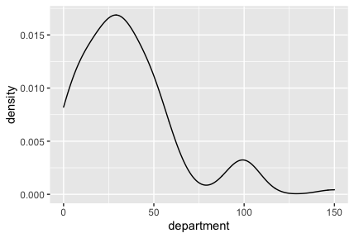
Measuring the Internal Reference Point
(Typical Expenditures)
3
Smoothed mode, identified using the maximum kernel density estimate
e.g.,
price
Notes:
Sample graph: UK, department store

Slide 17
Empirical Overview
6
Study 1a
  Basic Effect
Pre-registrations, materials, data, and code:
https://osf.io/wc57a/?view_only=7ffdf67fbde94892957830a1d6a90db2
Study 1b
Study 2
  Manipulating the Reference Point: Cutoffs
Study 3
  Smaller Restricted Discount vs. Larger Unrestricted Discount
Study 4
  Alternative Explanation:
  Purchase Preconditions Shift Expected Prices
Study 5
  Attenuating the Reference Effect: Percentage Discount
Study 6
  Attenuating the Reference Effect: Category Restriction
Notes:
Update: 1) Added the distribution builder study, 2) studies reordered (same order as the latest JMR paper), 3) Study 2 & 3 updated (we reran those two studies for JMR.

Slide 18
Study 1A
Basic Effect (Controlled Experiment)
10
n = 321 U.S. participants from Prolific
Participants evaluated a coupon for an electronics store
Between-participants
1) Unrestricted: Save $20
2) Restricted: Save $20 on Purchases above $40

Slide 19
11
DV: Deal Evaluation
“To what extent do you think this offer is a good deal?”
(1= not at all, 7 = very much)
Unrestricted Restricted
M = 5.17 < M = 6.06
SD = 1.30 SD = .97
p < .001

Slide 20
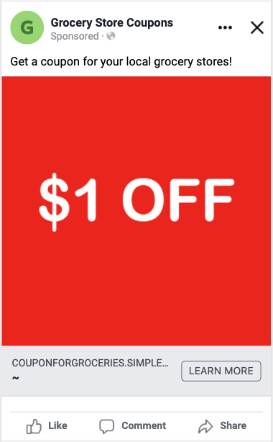
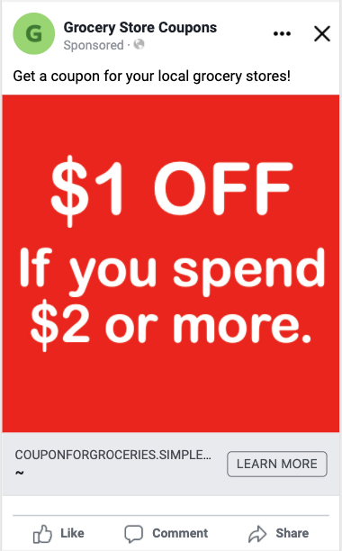
Study 1B
Basic Effect (Facebook Ads)
8

Slide 21
9
CTR = 0.88% CTR = 1.13%
p < .001
But note: Online Platform Studies are NOT randomized controlled trials!
Cornil, Y., Boegershausen, J., Yi, S., & Hardisty, D. J. (conditionally accepted). On the Persistent Mischaracterization of Google and Facebook A/B Tests: How to Conduct and Report Online Platform Studies International Journal of Research in Marketing.

Slide 22
Study 2
Manipulating the Reference Point-Cutoff
12
N = 314 UBC students
Imagine that you find a coupon in a flyer for a supermarket
Between-participants
1) Unrestricted:
“$5 off” promotion
2) Restricted, Low cutoff——below the IRP:
“$5 off a $15 purchase” promotion
3) Restricted, High cutoff——above the IRP:
“$5 off a $45 purchase” promotion
Notes:
Update: new manipulating cutoff study (high and low cutoffs being symmetric around the internal reference point $30). Results also updated.

Slide 23
Study 2
Manipulating the Reference Point-Cutoff
12
N = 314 UBC students
Imagine that you find a coupon in a flyer for a supermarket
Between-participants
1) Unrestricted: IRP = $30
“$5 off” promotion Feels like 17% OFF
2) Restricted, Low cutoff——below the IRP:
“$5 off a $15 purchase” promotion 33% OFF
3) Restricted, High cutoff——above the IRP:
“$5 off a $45 purchase” promotion 11% OFF
Notes:
Update: new manipulating cutoff study (high and low cutoffs being symmetric around the internal reference point $30). Results also updated.

Slide 24
14
Mediator: Perceived Magnitude of the Discount
“In your opinion, how large is this discount?”
1 = very small
7 = very big
DV: Redemption Intention
“How likely are you to visit the supermarket and redeem this coupon?
1 = very unlikely
7 = very likely

Slide 25
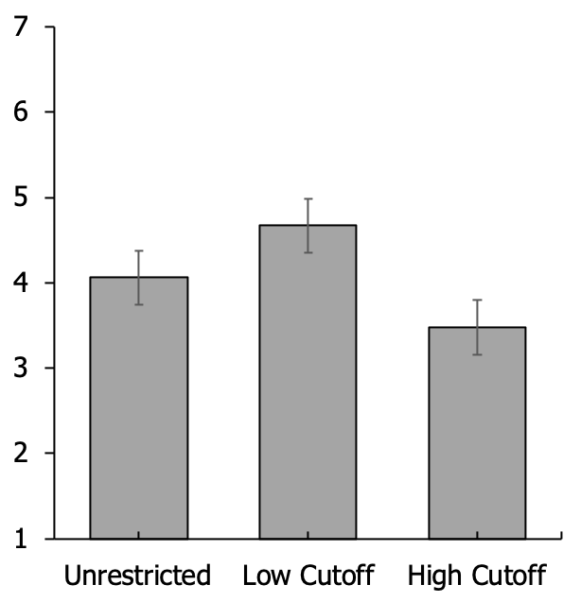
DV: Redemption Intention (Mean)
p = .008
p < .001
Error Bars = 95% CI
One-way ANOVA:
F (2, 311) = 37.13
p < .001

Slide 26
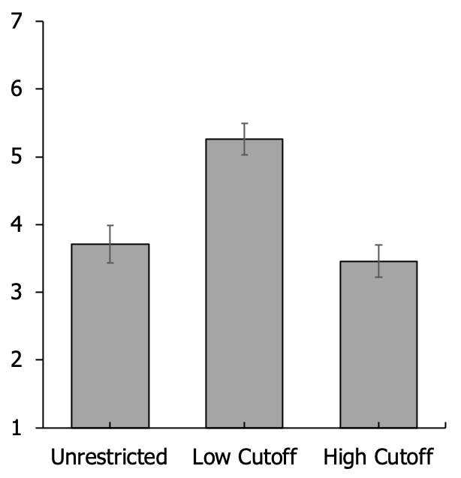
Mediator: Perceived Magnitude of the Discount (Mean)
p < .001
p < .001
Error Bars = 95% CI
One-way ANOVA:
F (2, 311) = 59.63
p < .001
Indirect Effect:
low cutoff vs. no restriction 95% CI = [.70, 1.31]
low cutoff vs. high cutoff
95% CI = [-1.56, -.91]

Slide 27
Study 3
Smaller Restricted Discount vs. Larger Unrestricted Discount
If a purchase precondition acts as an ERP that biases perceptions of discount magnitude
➣ Consumers may find a restricted price discount that offers a lower dollar discount more attractive than an unrestricted price discount that provides a higher dollar discount

Slide 28
Study 3
Smaller Restricted Discount vs. Larger Unrestricted Discount
N = 601 U.S. participants from Prolific
Between Participants: Supermarket Coupon
1) Unrestricted
“$2 off a product” promotion
2) Restricted
“$1 off a $2 product” promotion
Notes:
Update: not joint vs. separate anymore. We reran this study for JMR.

Slide 29
11
DV: Redemption Intention
Unrestricted Restricted
($2 off) ($1 off a $2 product)
M = 4.32 < M = 5.23
SD = 1.60 SD = 1.56
p < .001

Slide 30
11
Mediator: Perceived Discount Magnitude
($2 off) ($1 off a $2 product)
Unrestricted Restricted
M = 3.82 < M = 5.50
SD = 1.35 SD = 1.34
p < .001
Mediation
Indirect effect = 1.08, 95% CI = [.89, 1.27]

Slide 31
Study 4
Alternative Explanation:
Purchase Preconditions Shift Expected Prices
N = 1,002 U.S. participants from Prolific
Between Participants: Grocery Store Coupon
1) Unrestricted
“$2 off” promotion
2) Restricted
“$2 off a purchase above $4” promotion

Slide 32
11
Deal Evaluation
“To what extent do you think this offer is a good deal?”
(1= not at all, 7 = very much)
Unrestricted Restricted
M = 4.86 < M = 6.20
SD = 1.41 SD = .99
p < .001

Slide 33
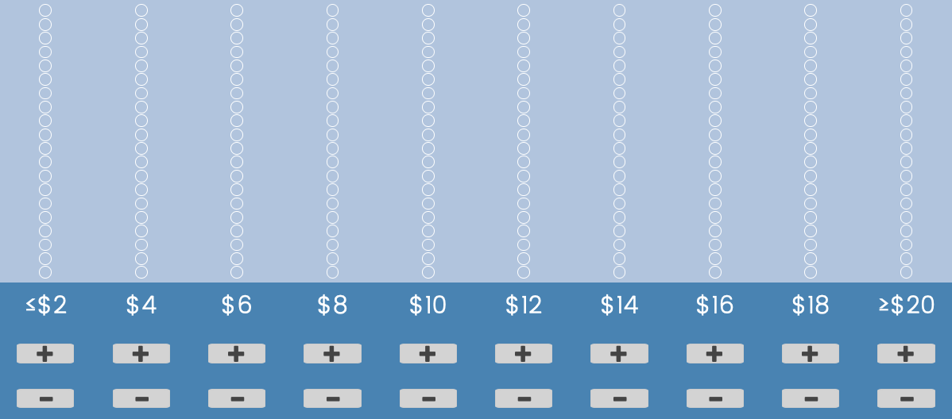
11
Distribution Builder
(Goldstein and Rothschild 2014)
Notes:
Next, we assessed participants’ expected price distributions for the products sold by the grocery store. Participants read, “Imagine that you see 20 random products from this grocery store. We would like to understand your expected price distribution for these 20 grocery store products. You will estimate this distribution using a ‘distribution builder,’ which you will find on the next screen. There will be 10 bars labeled from $2 to $20, each representing a different price range. Your objective is to allocate these 20 randomly selected products across these price ranges to estimate the price distribution of the products. For instance, if you believe that 2 products will cost around $10, simply click the ‘+’ button below $10 twice to assign two products to that price range.” Figure 2 presents an illustration of the distribution builder tool (Goldstein and Rothschild 2014)

Slide 34
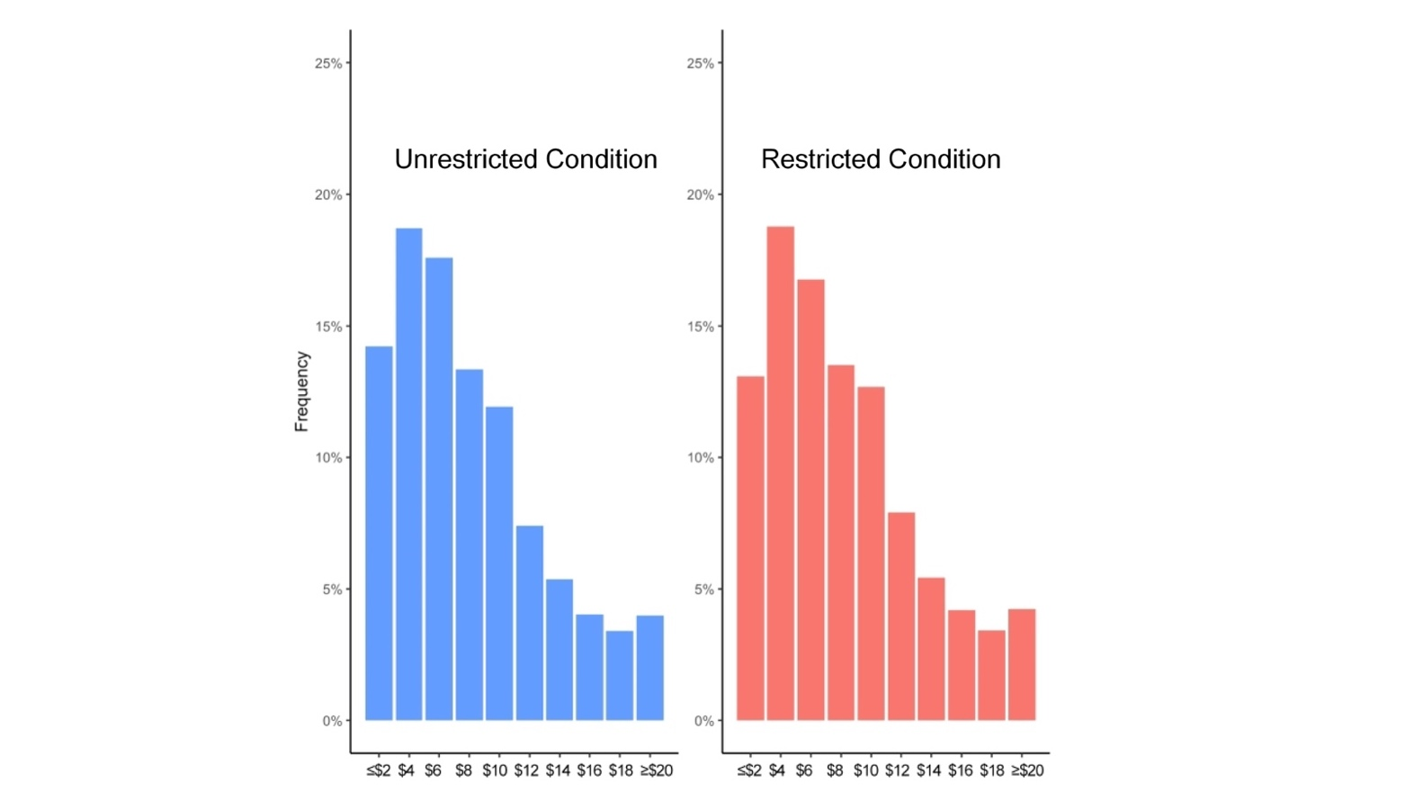
11
Averaged Distribution
Two One-Sided Tests (TOST) Procedure (Lakens 2017)
Comparison against d = 0.2
1) Distribution means:
significantly equivalent
2) Distribution standard deviations:
significantly equivalent

Slide 35
11
Averaged Distribution
Comparison of the number of products allocated to each of the 10 brackets across conditions
All p values > .14

Slide 36
Study 5
Attenuating the Reference Effect – Percentage Discount
N = 400 U.K. participants from Prolific
Imagine that you find a coupon in a flyer for a department store near where you live
2 × 2 Between-participants
Discount format:
Absolute (£2 off any purchase) vs. Percentage (10% off any purchase)
Purchase precondition:
Unrestricted vs. Restricted (minimum purchase £3)

Slide 37
Mediator: Perceived magnitude of the discount
“In your opinion, how large is this discount?”
1 = very small
7 = very big
DV: Redemption Intention
“How likely are you to redeem this coupon?”
1 = very unlikely
7 = very likely

Slide 38
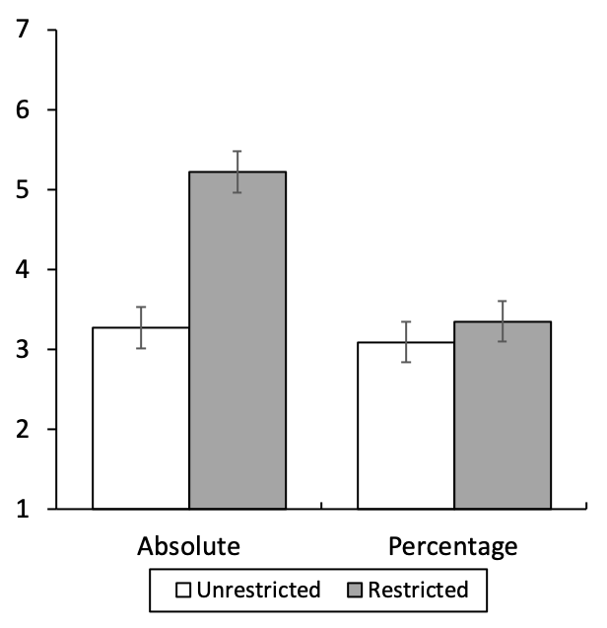
DV: Redemption Intention (Mean)
p = .003
NS
Error Bars = 95% CI
Interaction:
F (1, 396) = 9.14
p = .003

Slide 39
Mediator: Perceived Magnitude of the Discount (Mean)
p < .001
NS
Error Bars = 95% CI
Interaction:
F (1, 396) = 41.54
p < .001

Slide 40
Moderated Mediation
Discount Format
Perceived Magnitude
Precondition
Likelihood of Redemption
Significant Moderated Mediation (Model 7)
Absolute Format: Significant Mediation, 95% CI = [.81, 1.38]
Percentage Format: No Mediation, 95% CI = [-.16, .28]
Notes:
Notably, this study rules out several alternative explanations. For example, it could be argued that a purchase precondition draws consumers’ attention to the offer or makes the offer appear scarce, thus creating the perception that the discount is of higher value. Or, it could be argued that the purchase precondition makes consumers think of a specific product, improving the imaginability of the potential purchase and thereby making it more attractive. However, had the phenomenon been driven by these alternative explanations, the purchase precondition in this study should have boosted perceived discount magnitude and coupon redemption intentions in both the absolute and relative format conditions.

Slide 41
Study 6
Attenuating the Reference Effect – Category Restriction
Category restrictions as implicit ERPs
N = 1307 U.S. participants from Prolific
2 × 2 Between-participants: “$1 Off” Supermarket Coupon
Purchase precondition:
Unrestricted vs. Restricted (above $2)
Equivalent category restriction:
Unrestricted vs. Restricted (a bottle of juice, 12 oz)
Notes:
According to US government data, average price of 12oz of juice = $2

Slide 42
Mediator: Perceived magnitude of the discount
“In your opinion, how large is this discount?”
1 = very small
7 = very big
DV: Redemption Intention
“How likely are you to redeem this coupon?”
1 = very unlikely
7 = very likely

Slide 43
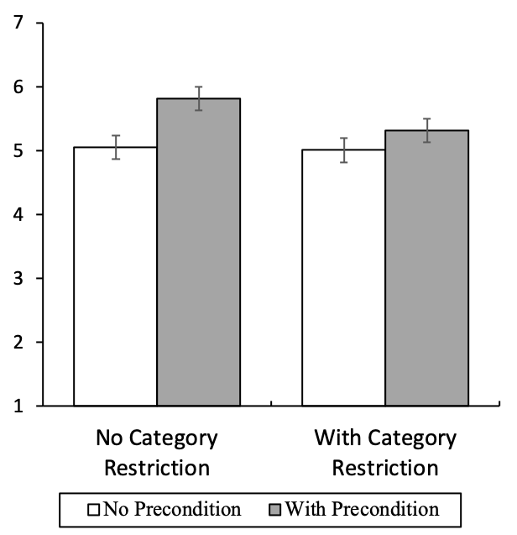
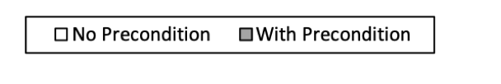
DV: Redemption Intention (Mean)
p < .001
p = .02
Error Bars = 95% CI
Interaction:
F (1, 1303) = 5.98
p = .02

Slide 44
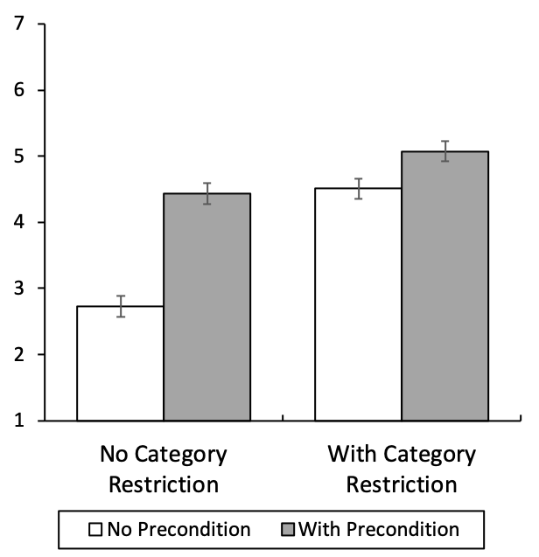
Mediator: Perceived Magnitude of the Discount (Mean)
p < .001
p < .001
Error Bars = 95% CI
Interaction:
F (1, 1303) = 52.21
p < .001

Slide 45
Moderated Mediation
Equivalent
Category Restriction
Perceived Magnitude
Precondition
Likelihood of Redemption
Significant Moderated Mediation (Model 7)
Without Category Restriction: Indirect Effect = .66, 95% CI = [.53, .81]
With Category Restriction: (Attenuated) Indirect Effect = .22, 95% CI = [.14, .31]

Slide 46
Contributions
A new lens for understanding purchase preconditions: ERPs that affect the magnitude of a discount as perceived by consumers.
An externally supplied reference point can generate more positive consumer reactions even when it makes the offer objectively worse economically——a novel dominance violation.

Slide 47

Promotion Architecture:
The Perceived Fairness of Restricted Price Promotions

Slide 48

Shangwen Yi

Slide 49
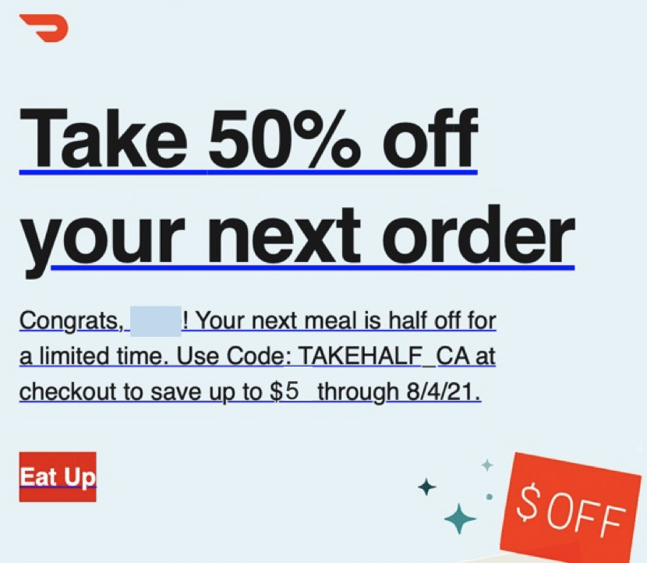
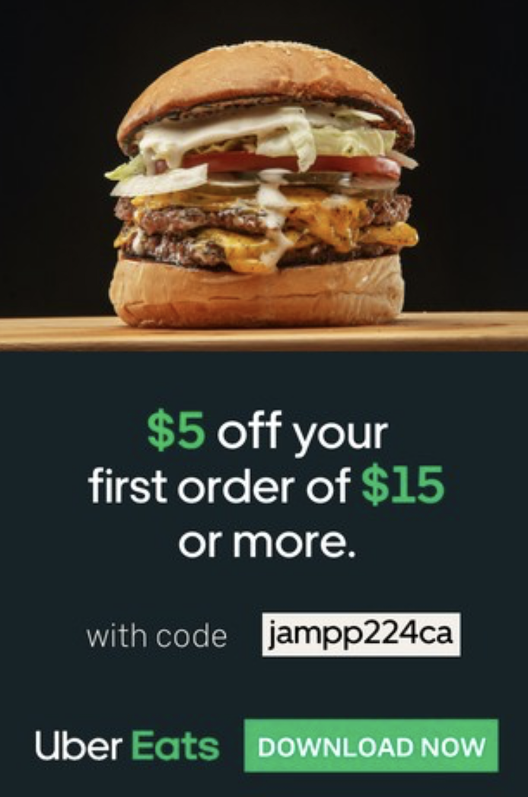
Restricted Promotions: Food Delivery
Capped Promotion
Threshold Promotion
Threshold
Cap
Notes:
ResPromotions have been extensively utilized in the context of food delivery. I am going to show you a couple of examples of restricted promotions.
This is a promotion that I receivedfrom DoorDash offering 50% off, up to $5.
ype of promotion as a "capped promotion,"
where a percentage discount is applied, up to a maximum value limit.
On another day, I received a coupon from Uber Eats offering $5 off an order of $15 or more.
I call this type of promotion a "threshold promotion,"
where the discount applies only when the order meets a minimum spending precondition.
100 US participants, 86% have seen threshold promotions, 76% have seen capped promotions, and 73% have seen unrestricted promotions, which indicates that the two restricted promotions are as common as (if not more common) unrestricted promotions nowadays.
An Unrestricted Promotion is an offer that has no purchase preconditions or limits, for example, “$5 off” or "50% off".
Have you seen an Unrestricted Promotion before?
A Threshold Promotion is an offer that has a spending amount precondition, for example, “$5 off on orders of $10 or more”.
Have you seen a Threshold Promotion before?
A Capped Promotion is an offer that has a maximum value limit, for example, “50% off with a maximum discount of $5”.
Have you seen a Capped Promotion before?

Slide 50
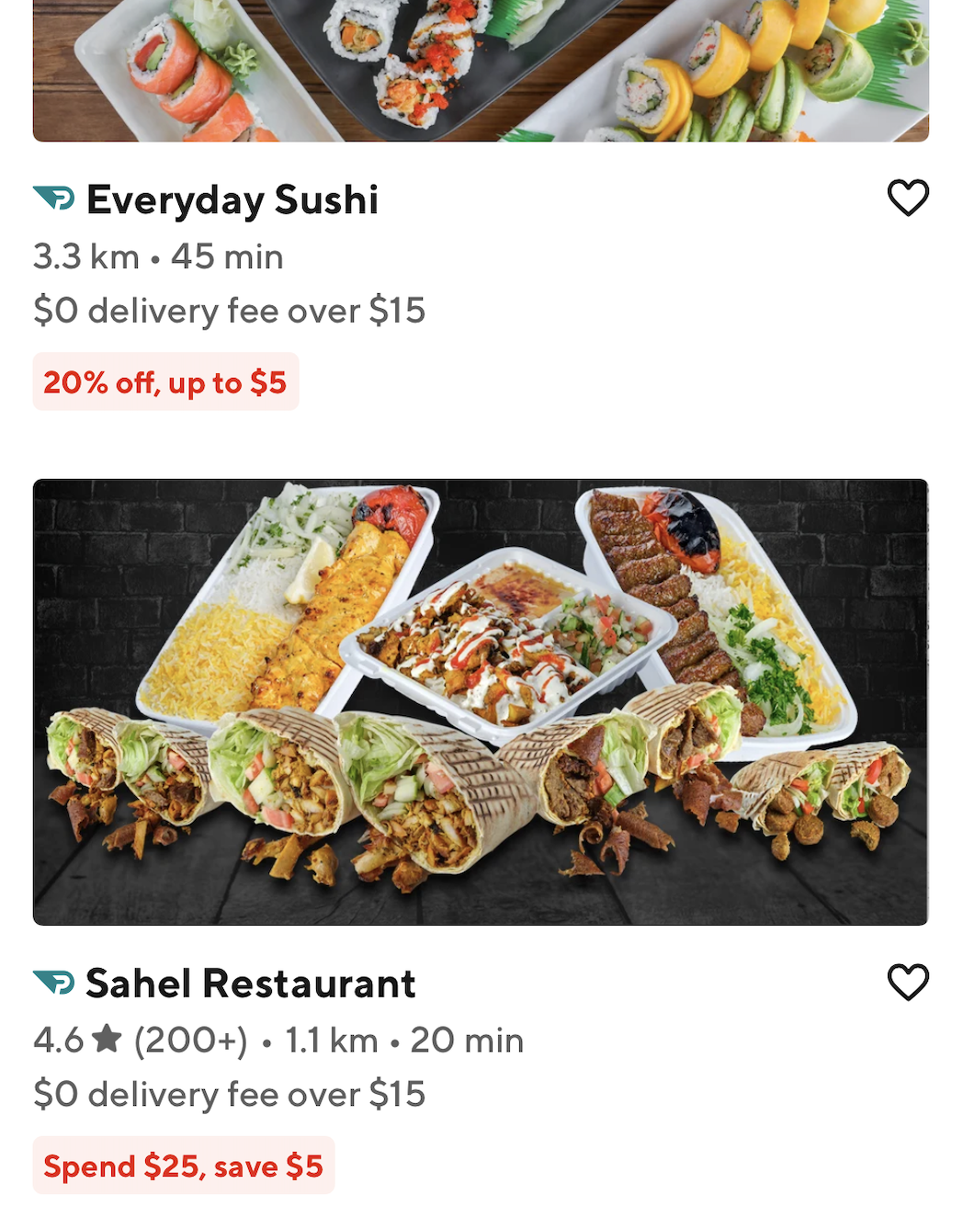
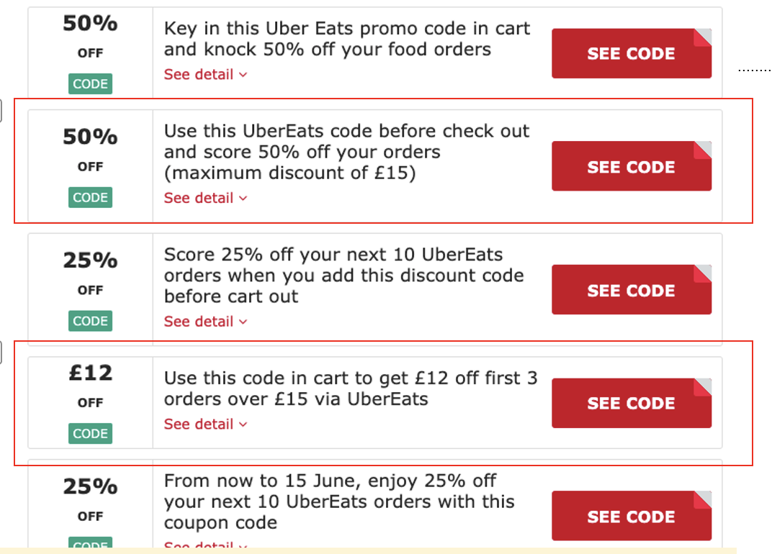
55%
24%
Couponfollow.com
Notes:
I am not saying that they only use one of them. Couponfollow.com
80%
Results showed that 55% of the stores used capped promotions, 24% used threshold promotions, and the rest, 21%, were free-delivery promotions. Thus, restricted promotions (capped and threshold types) are the dominant types used on DoorDash.

Slide 51
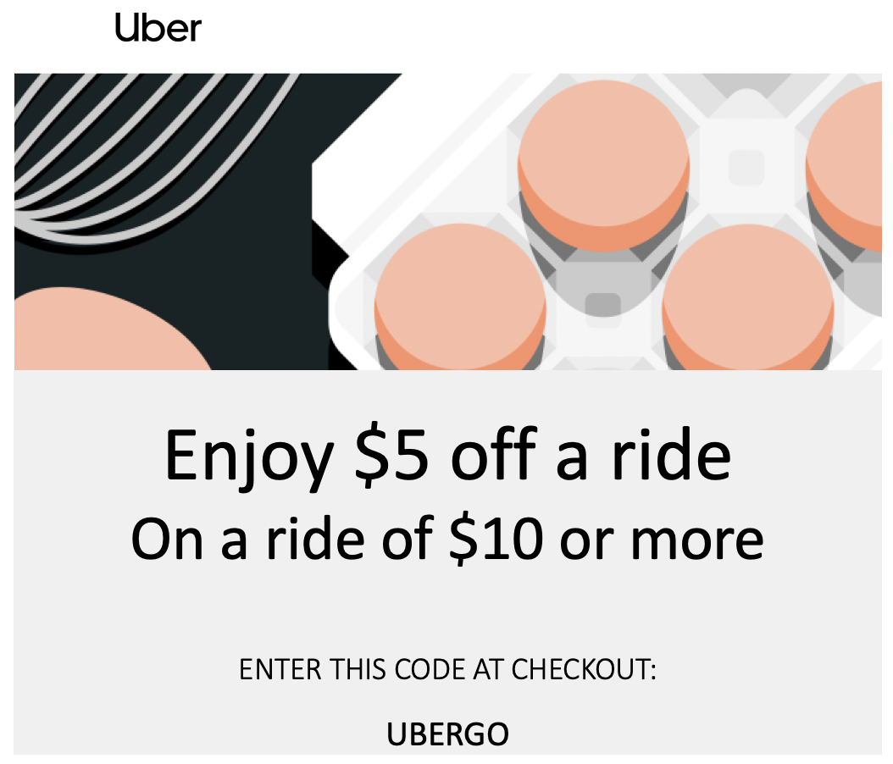
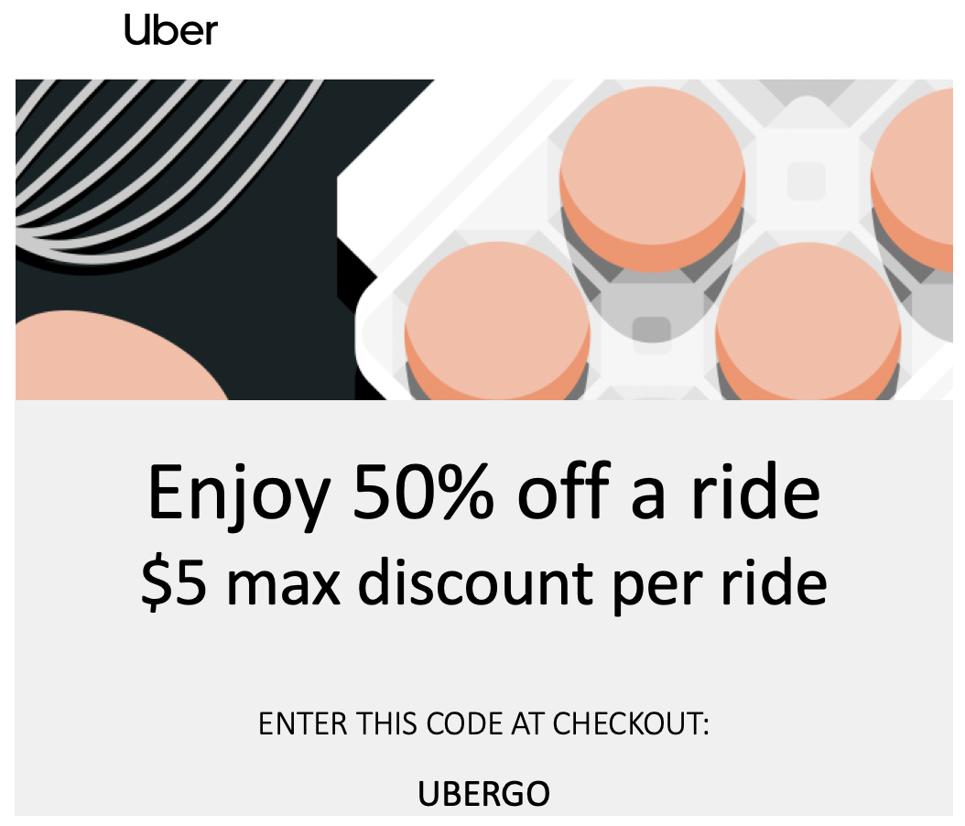
Promotion Architecture
Threshold Promotion
Capped Promotion
Notes:
For promotions such as “$5 off if you spend $10 or more,” we use the term threshold promotions, referring to promotions that are only applicable if the amount exceeds a stated value. Alternatively, for promotions such as “Take 50% off, up to $5 discount,” we use the term capped promotions, referring to promotions with percentage-term reward caps at a maximum stated value.

Slide 52
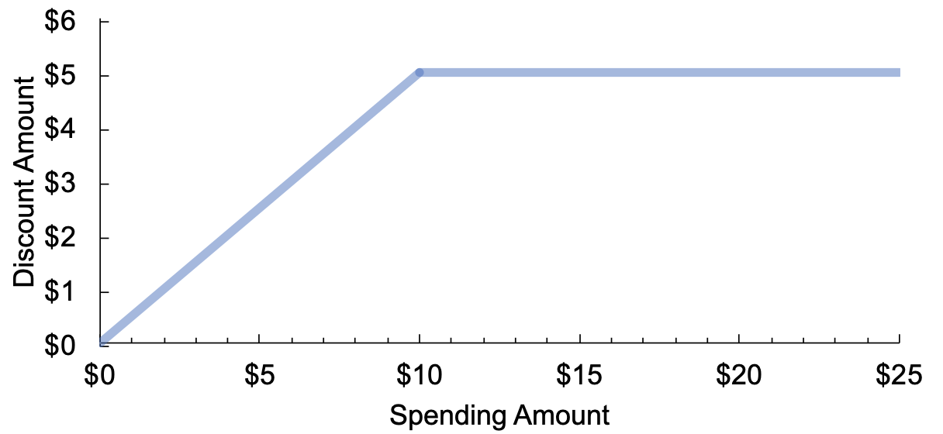
Economic Value
Capped (50% off, up to $5)
Trigger Value
Threshold ($5 off, min $10)
Notes:
Let me explain more how the two are comparable in economic values.
In this graph, the X-axis represents the spending amount, while the Y-axis represents the discount amount. The blue line represents the capped promotion, 50% off, up to $5.
Now, let's look at the threshold promotion, $5 off on orders of $10 or more, which is represented by the yellow line.
We can clearly see that when people spend less than $10, which we call the trigger value, the capped promotion leads to a higher discount. However, when people spend $10 or more, both promotions offer a $5 discount.
the lower the trigger value is, the more similar the two are. Theoretically, 100% off, up to$5 = $5 off, min $0

Slide 53
Equity: Capped vs Threshold Promotion
Equity theory: fairness perceptions derive from comparing the outcome-input ratio with a reference ratio (Adams 1965)
Enjoy 50% off
$5 max discount on an order
Enjoy $5 off
On an order of $10 or more
Capped promotions
Threshold promotions
Exaggerated reference and higher expectation for discount (Urbany et al. 1988)
Negative expectation disconfirmation (Oliver et al. 1994)
A lowered reference for spending amount and a heightened attractiveness of discount (Mao 2016; Sokolova 2022; Tversky and Kahneman 1981)
Lower perceived fairness (Darke and Dahl 2003; Thaler 1985)
Notes:
Perceived merits of the deal
There is a discount reference in mind
Normal ride as reference $20 compared to normal ride
Now threshold only $10

Slide 54
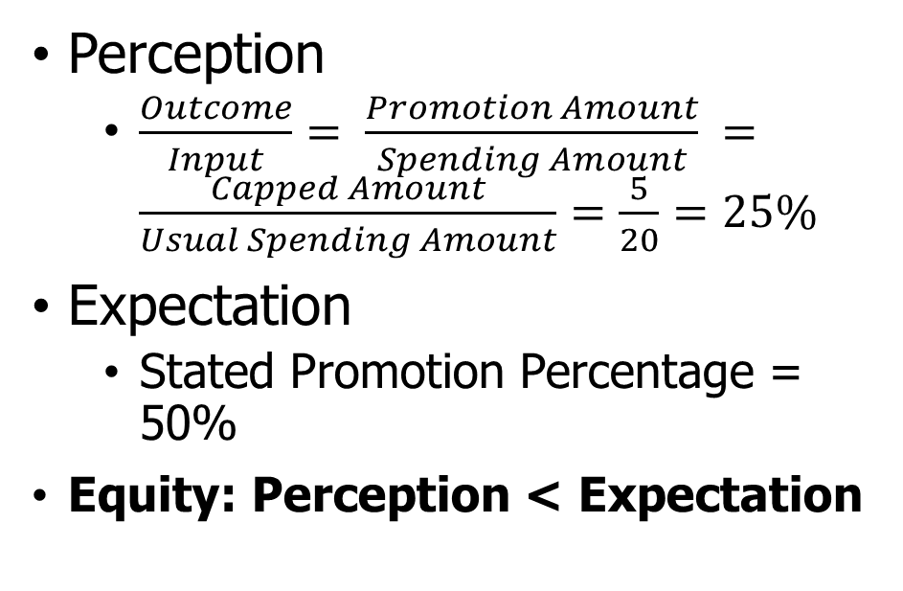
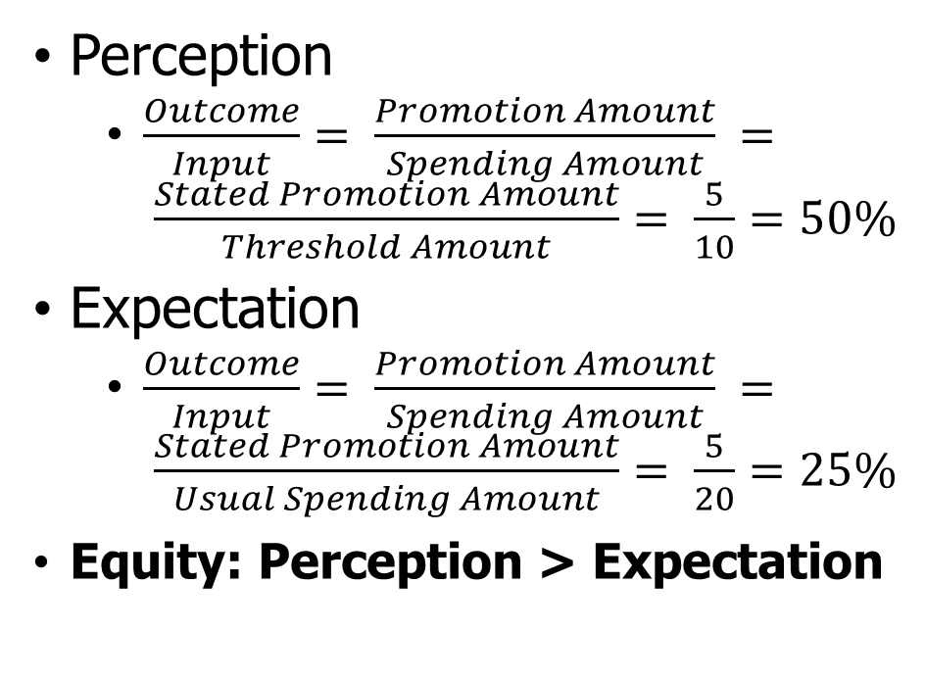
Trigger Value: Low ($10)
Enjoy 50% off
$5 max discount on an order
Enjoy $5 off
On an order of $10 or more
Capped promotions
Threshold promotions
Perception
  $\frac{Outcome}{Input}= \frac{Promotion Amount}{Spending Amount} =\frac{Capped Amount}{Usual Spending Amount}=\frac{5}{20}=25\%$
Expectation
  Stated Promotion Percentage = 50%
Equity: Perception < Expectation
Perception
  $\frac{Outcome}{Input}= \frac{Promotion Amount}{Spending Amount} = \frac{Stated Promotion Amount}{Threshold Amount}= \frac{5}{10}=50\%$
Expectation
  $\frac{Outcome}{Input}= \frac{Promotion Amount}{Spending Amount} = \frac{Stated Promotion Amount}{Usual Spending Amount}= \frac{5}{20}=25\%$
Equity: Perception > Expectation
Notes:
Counterfactual no restriction
There is a discount reference in mind
Normal ride as reference $20 compared to normal ride
Now threshold only $10

Slide 55
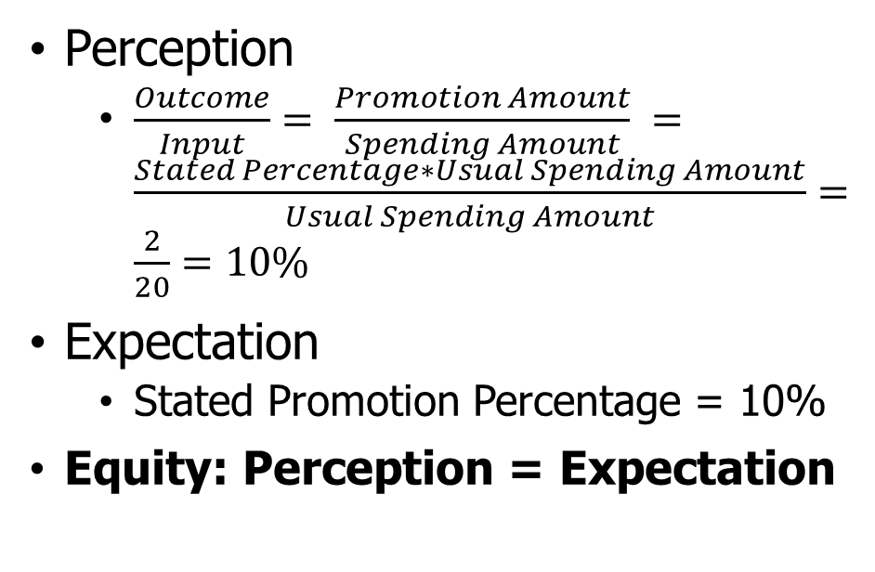
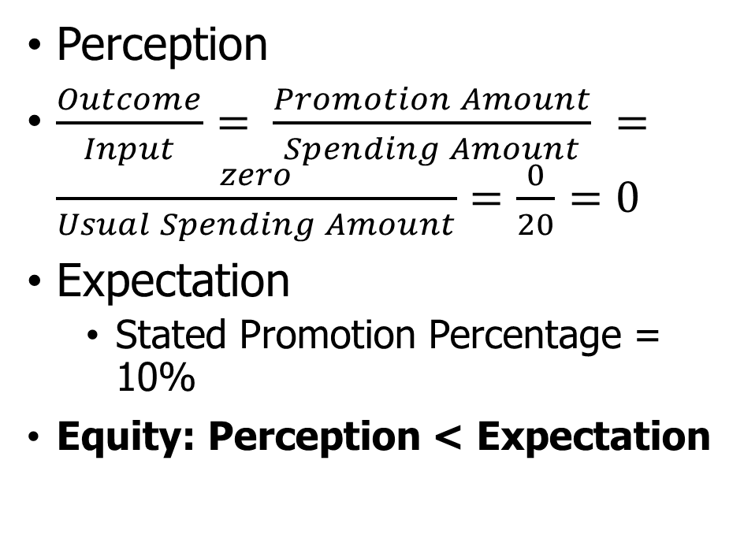
Trigger Value: High ($50)
Enjoy 10% off
$5 max discount on an order
Enjoy $5 off
On an order of $50 or more
Threshold promotions
Capped promotions
Perception
$\frac{Outcome}{Input}= \frac{Promotion Amount}{Spending Amount} =\frac{zero}{Usual Spending Amount}=\frac{0}{20}=0$
Expectation
  Stated Promotion Percentage = 10%
Equity: Perception < Expectation
Perception
  $\frac{Outcome}{Input}= \frac{Promotion Amount}{Spending Amount} =\frac{Stated Percentage∗Usual Spending Amount}{Usual Spending Amount}=\frac{2}{20}=10\%$
Expectation
  Stated Promotion Percentage = 10%
Equity: Perception = Expectation
Notes:
Perceived merits of the deal
There is a discount reference in mind
Normal ride as reference $20 compared to normal ride
Now threshold only $10

Slide 56
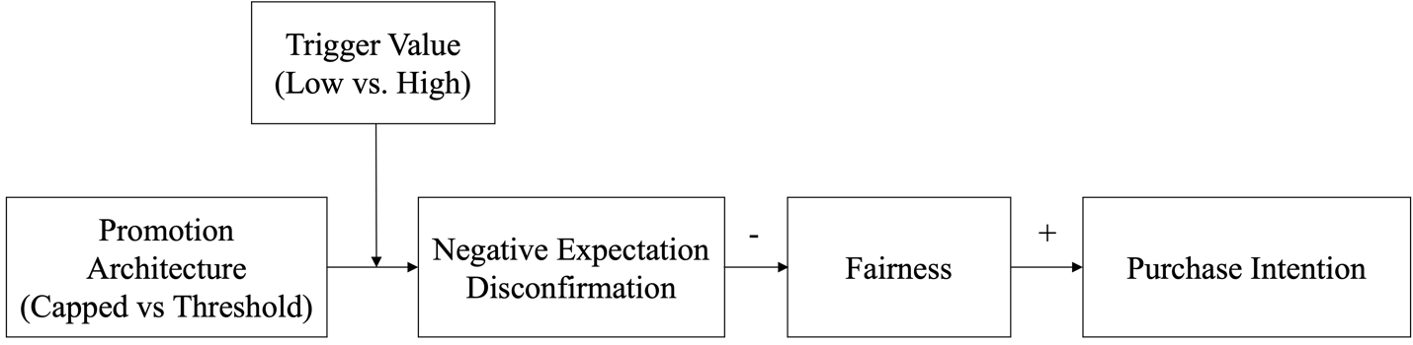
Hypotheses and Framework
Pre-registrations, materials, data, and code:
https://osf.io/tnhvb/?view_only=0b5763ed25084a35a336ca91bd0218ae

Slide 57
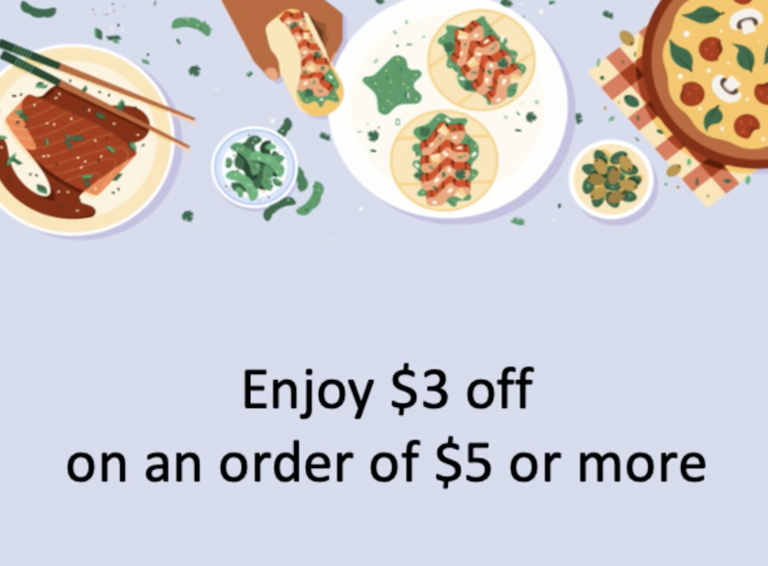
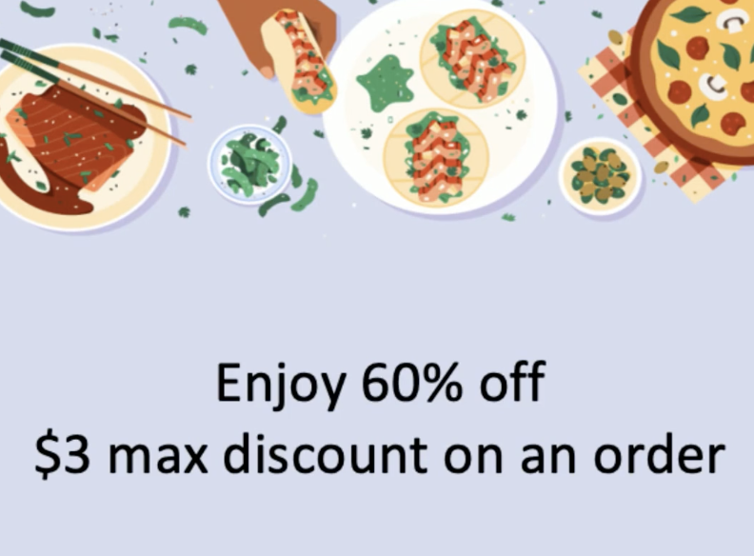
Study 1 Food Ordering Field Study
TikTok
Ecological Validity
Reach
  N_{Threshold} = 61,895
  N_{Capped} = 65,548
Click-through rate = Clicks/Reach
Threshold (1.38%) > Capped (1.25%),
p = .021*
* Pre-registered one-tailed proportion test

Slide 58
Study 2: Ride-Hailing
Take a bus or to hail a taxi to go home from work.
2 (Promotion Architecture) X 2 (Average Spending Information)
Promotion Architecture
Average Spending Information
  Present: “If you hail a ride, you will spend $20 on average”
  Absent: no information
Capped
Threshold
(N = 403, Canadian Prolific)

Slide 59
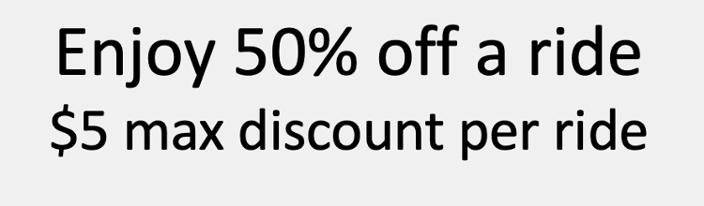
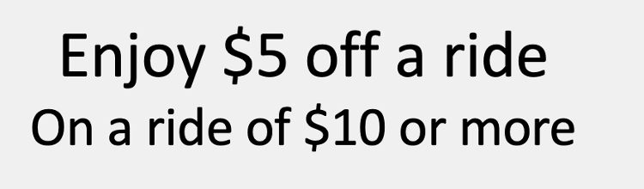
Study 2 Results – Offer Evaluation
Capped
Threshold
Main effect of promotion framing, p <.001
Notes:
Logistic regression
X axis
Y axis
Error bar
We did not find a significant interaction effect between promotion framing and spending information, Wald χ²(1) = 0.37, p = .546.
We did not find a main effect of spending information, Wald χ²(1) = 0.23, p = .635.

Slide 60
Study 2 Results - Conversion Rate
Capped
Threshold
Main effect of promotion framing, p =.017
Notes:
Logistic regression
X axis
Y axis
Error bar
We did not find a significant interaction effect between promotion framing and spending information, Wald χ²(1) = 0.37, p = .546.
We did not find a main effect of spending information, Wald χ²(1) = 0.23, p = .635.

Slide 61
Study 3: Charity Promotion
Imagine that you are going to buy some groceries for next week and receive the following message from Amazon Whole Foods Market app.
Threshold: “We donate $5 per purchase (if you purchase $10 or more) on the app to support Organic Farming Research Foundation.”
Capped: “We donate 50% of your purchase price (up to $5 per purchase) on the app to support Organic Farming Research Foundation”
(N = 403, US Prolific)
Notes:
A distinct promotion context: charity promotion
Examine expectation and fairness perception as mechanism

Slide 62
Study 3 Measures and Results
Purchase intention (C < T, p = .039)
  How likely are you to download Amazon Whole Foods Market app and make a purchase?
Morality perception (C < T, p = .050)
  How moral is Amazon Whole Food Market?
Fairness (C < T, p < .001)
  The donation amount is fair
Negative expectation discrepancy (C > T, p < .001)
  The donation amount is below my expectation
Applicability (C > T, p < .001)
  The donation applies to all orders
Capped (C):
We donate 50% of your purchase price (up to $5 per purchase)
Threshold (T):
We donate $5 per purchase (if you purchase $10 or more)

Slide 63
Study 3 Results
Indirect Effect: -.23 (.05), bootstrapped 95% CI = [-0.34, -0.14].
Indirect Effect: .13 (.06), bootstrapped 95% CI = [0.03, 0.25].
Applicability
B = 0.91***
B = .17***
Capped(1) vs Threshold (0)
Purchase Intention
Purchase Intention
B = -.06
Notes:
A mediation analysis using Process Macro (Model 6; Hayes) reveal that the effect of promotion framing on purchase intention is serially mediated by negative expectation disconfirmation and fairness perception, the indirect effect is 0.23 (BootSE = 0.05), bootstrapped 95% CI = [0.14, 0.34].
Similarly, the effect of promotion framing on morality perception is serially mediated by negative expectation disconfirmation and fairness perception, and the indirect effect is 0.26 (BootSE = 0.05), bootstrapped 95% CI = [0.18, 0.36].

Slide 64
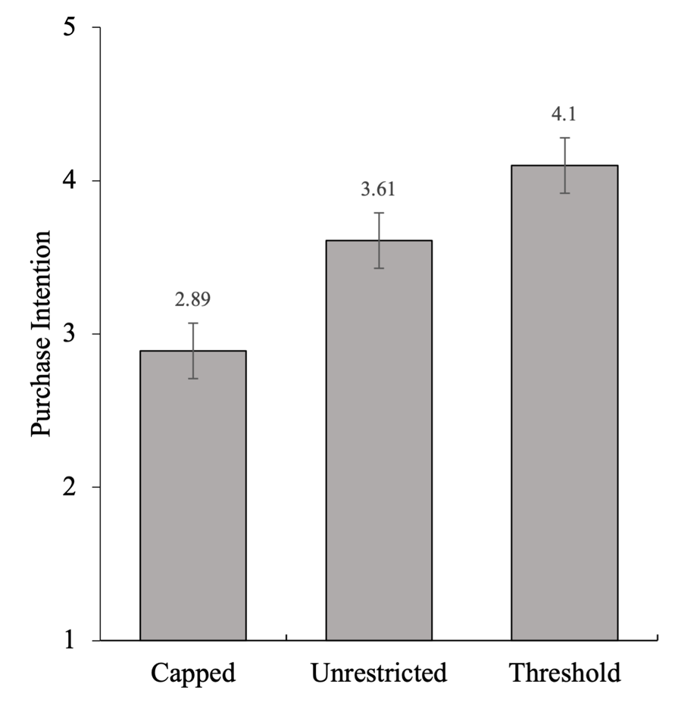
Study 4: Unrestricted Promotion as a Reference
Capped: "Enjoy 60% off. $3 max discount on an order”
Threshold: "Enjoy $3 off on an order of $5 or more”
Unrestricted: "Enjoy $3 off”
Fairness & Purchase Intention (Counterbalanced)
Note: Error bars = ±1 standard error.
(N = 600, US Prolific)

Slide 65
Study 4: Unrestricted Promotion as a Reference
Perception (Capped)
  $\frac{Outcome}{Input}= \frac{Promotion Amount}{Spending Amount} =\frac{Capped Amount}{Usual Spending Amount}=\frac{3}{24}=12.5\%$
Expectation (Unrestricted Percentage)
  Stated Promotion Percentage = 60%
Perception (Threshold)
  $\frac{Outcome}{Input}= \frac{Promotion Amount}{Spending Amount} = \frac{Stated Promotion Amount}{Threshold Amount}= \frac{3}{5}=60\%$
Expectation (Unrestricted Dollar)
  $\frac{Outcome}{Input}= \frac{Promotion Amount}{Spending Amount} = \frac{Stated Promotion Amount}{Usual Spending Amount}= \frac{3}{24}=12.5\%$
(N = 600, US Prolific)

Slide 66
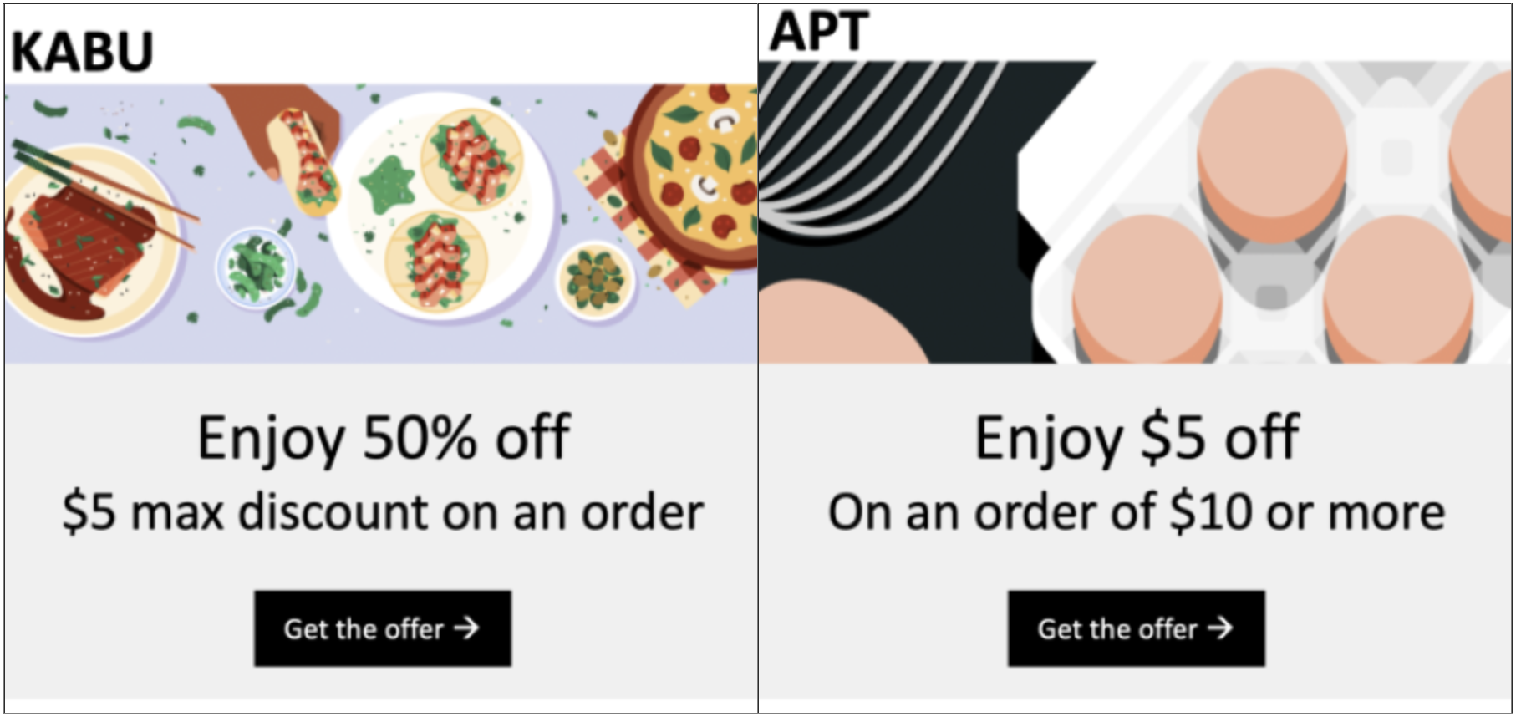
Study 5 Joint Evaluation in Food Ordering
Imagine that you are thinking of downloading a food ordering app, and notice the promotions from two apps, KABU or APT.
Capped 38.5%
Threshold 61.5%
χ²(1) = 10.58, p = .001
(N = 200, US Prolific)
Notes:
In TC condition, participants saw threshold discount first, and capped discount second.
In CT condition, participants saw capped discount first, and threshold discount next (CT condition).

Slide 67
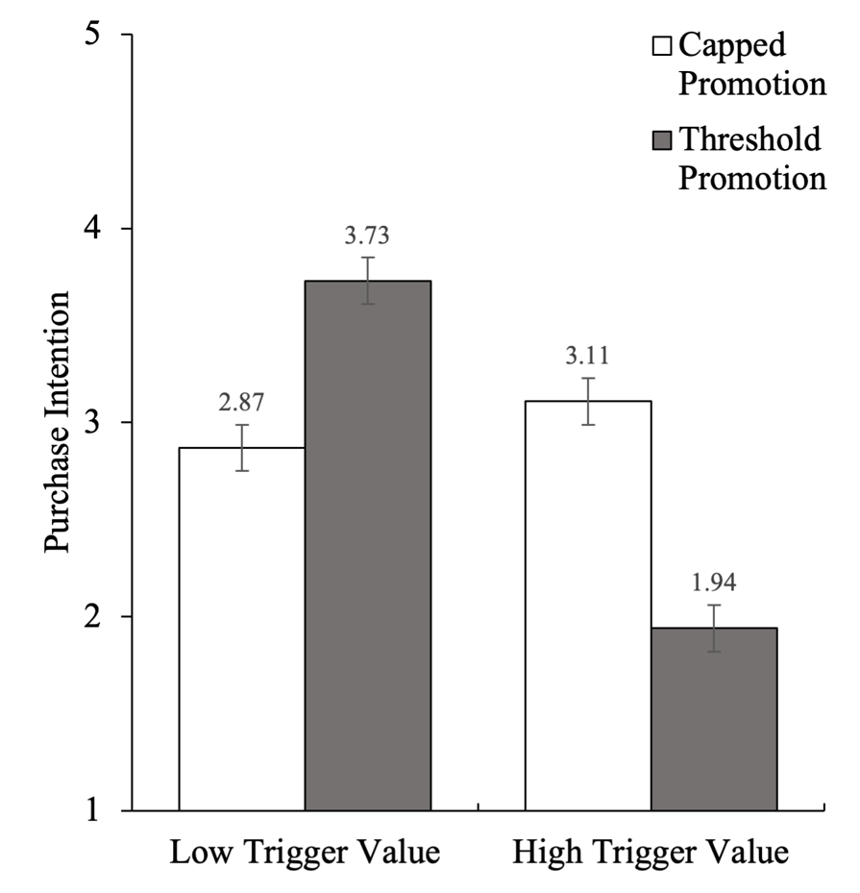
Study 6 Trigger Value as a Moderator
Low Trigger Level ($10)
  Threshold: Enjoy $5 off (On an order of $10 or more)
  Capped: Enjoy 50% off ($5 max discount on an order)
High Tigger Level ($50)
  Threshold: Enjoy $5 off (On an order of $50 or more)
  Capped: Enjoy 10% off ($5 max discount on an order)
Purchase intention and fairness perception
(N = 398, US Prolific)
Note: Error bars represent ±1 standard error
Notes:
Fairness Perception. Same results and “Enjoy 10% off ($5 max discount on an order)” is significantly higher than “Enjoy 50% off ($5 max discount on an order)”
This may talk about expectation disconfirmation mechanism

Slide 68
Study 7: Overall Sales
Food ordering
Capped: "Enjoy 40% off ($6 max discount on an order).”
Threshold: "Enjoy $6 off (On an order of $15 or more).”
Deal evaluation (same as Study 2)
Coupon conversion and purchase amount(binary)
  Whether they would use the offer and make an order
  If yes, how much money they were likely to spend before the discount was subtracted.
(N = 278, UBC students)

Slide 69
Study 7: Overall Sales
Deal evaluation
  Threshold discount (M = 6.94, SD = 1.35) > capped discount (M = 5.03, SD = 1.93), t(276) = 9.66, p < .001, Cohen’s d = 1.15.
Conversion rate
  Threshold discount (85.61%) > capped discount (50.36%), Wald χ2(1) = 35.90, p < .001.
Purchase amount (among who intend to make an order)
  Threshold discount (M = 18.59, SD = 3.87) < capped discount (M = 23.06, SD = 10.78), t(187) = 4.10, p < .001, Cohen’s d = 0.62.
Purchase amount (all participants)
  Threshold discount (M = 15.91, SD = 7.46) > capped discount (M = 11.61, SD = 13.86), z = 3.42, p < .001, bootstrapped 95% CI of difference [$1.71, $6.80]
Payment amount (all participants; after the discount amount considered)
  Threshold discount (M = 10.78, SD = 5.70) > capped discount (M = 8.61, SD = 11.46), z = 3.42, p < .001, bootstrapped 95% CI of difference [$0.03, $4.21]
(N = 278, UBC students)

Slide 70
Takeaways
When the trigger value is low, consumers prefer threshold promotions to capped promotions.
When the trigger value is high, consumers prefer capped promotions to threshold promotions.
Consumers prefer promotions whose outcome-input ratio are higher than the expected reference ratio.

Slide 71
Implications
Propose an equity theory of restricted promotions
1
Illustrate a promotion strategy that is less costly and more appealing
2
New online field study methods
3
Notes:
Take away

Slide 72


Thank you!
And all of you!
Questions

Slide 73
THANK YOU!

Slide 74
Study 7: Various Levels of Promotion Depth
Enjoy X% off ($3 max discount on an order)
X ∈ {10%, 20%, 30%, 40%, 50%, 60%}
p = .055
p = .015
N = 599, US Prolific; 7-point scale; Error bars:±1 standard error
Notes:
In this study, participants always see a capped promotion with a cap of $3, but the percentage varies from 10 to 60.
So, altogether there are six conditions. Economically, a larger percentage is always better or equivalent to a low percentage one.
However, I again find that the effect of percentage on deal evaluation and fairness perception is negative.
fairness perception (“Is the offer shown above a fair deal?” 1 = Not fair at all, 7 = Very fair)
deal evaluation (“Is the offer shown above a bad or good deal?” 1 = A very bad deal, 7 = A very good deal).

Slide 75
Study 8 Total Sales and Thought Listing
“Imagine you are deciding whether to order out or cook dinner at home.”
Threshold
  “Enjoy $6 off (On an order of $15 or more)”
Capped
  “Enjoy 40% off ($6 max discount on an order)”
Thought Listing
  “Write down anything crossing your mind as you considered the offer.”
Deal evaluation, conversion
Purchase amount
N = 278, college students
Notes:
Students
Would the high deal evaluation also transfer to purchase amount, or the low threshold leads to lower spending amount
Participants were first asked to write down anything crossing their mind as they considered the offer.
Then, they completed the same measure of deal evaluation used in Study 2 and indicated whether they would use the offer and make an order (coupon conversion, binary). Participants who answered “yes” to the conversion question were further asked to indicate how much money they were likely to spend before the discount was subtracted.

Slide 76
Study 8 Deal Evaluation & Conversion
***
***
N = 278, college students; Error bars:±1 standard error

Slide 77
Study 8 Purchase Amount
***
(N = 70)
(N = 119)
N = 189, college students; Error bars:±1 standard error
Notes:
10.1% vs 32.4% indicate 15
N1 = 70/139 (50%)
N2 = 119/139 (85%)
Overall sales: the value of the goods that are expected to sell, this may help with the inventory management
Among those who would make an order, the purchase amount was smaller when the coupon was a threshold promotion (M = 18.59, SD = 3.87) than when the coupon was a capped promotion (M = 23.06, SD = 10.78), t(187) = 4.10, p < .001, Cohen’s d = 0.62. However, after taking the proportion of those who would make an order into consideration (non-choosers coded as $0), a Mann-Whitney U test suggested that participants overall tended to spend more when it was the threshold promotion (M = 15.91, SD = 7.46) than when it was the capped promotion (M = 11.61, SD = 13.86), U = 7432.50, z = 3.42, p < .001. Consistent with this, the overall sales for the threshold promotion ($2,212.21) are larger than that for the capped promotion ($1,614.20). As a robustness check, using a bootstrapped method, we found that the 95% CI for the mean difference in individual spending (threshold - cap) is [$1.71, $6.80].

Slide 78
Capped (N = 70)
Threshold (N = 119)
 | Frequency | Percent
12 | 2 | 2.9
15 | 14 | 20.0
16 | 1 | 1.4
18 | 5 | 7.1
20 | 24 | 34.3
21 | 1 | 1.4
24 | 2 | 2.9
25 | 6 | 8.6
30 | 8 | 11.4
35 | 3 | 4.3
40 | 1 | 1.4
50 | 1 | 1.4
60 | 1 | 1.4
80 | 1 | 1.4
 | Frequency | Percent
15 | 45 | 37.8
16 | 6 | 5.0
17 | 5 | 4.2
18 | 7 | 5.9
19 | 1 | 0.8
20 | 35 | 29.4
22 | 2 | 1.7
24 | 1 | 0.8
25 | 13 | 10.9
28 | 1 | 0.8
30 | 3 | 2.5

Slide 79
Study 8 Purchase Amount
***
***
***
(N = 70)
(N = 119)
(N = 139)
(N = 139)
College students; Error bars:±1 standard error
Notes:
10.1% vs 32.4% indicate 15
N1 = 70/139 (50%)
N2 = 119/139 (85%)
Overall sales: the value of the goods that are expected to sell, this may help with the inventory management
Among those who would make an order, the purchase amount was smaller when the coupon was a threshold promotion (M = 18.59, SD = 3.87) than when the coupon was a capped promotion (M = 23.06, SD = 10.78), t(187) = 4.10, p < .001, Cohen’s d = 0.62. However, after taking the proportion of those who would make an order into consideration (non-choosers coded as $0), a Mann-Whitney U test suggested that participants overall tended to spend more when it was the threshold promotion (M = 15.91, SD = 7.46) than when it was the capped promotion (M = 11.61, SD = 13.86), U = 7432.50, z = 3.42, p < .001. Consistent with this, the overall sales for the threshold promotion ($2,212.21) are larger than that for the capped promotion ($1,614.20). As a robustness check, using a bootstrapped method, we found that the 95% CI for the mean difference in individual spending (threshold - cap) is [$1.71, $6.80].
Total sales (N = 278)
Capped promotion ($1,614.20)
Threshold promotion ($2,212.21)
95% CI: [$1.71, $6.80]

Slide 80
Study 8 Fairness Sentiment
Extended Moral Foundations Dictionary (Hopp et al. 2021)
Fairness Sentiment
*
-.01*
6.48*
Capped (vs Threshold)
-1.85***
Deal Evaluation
Indirect effect: -0.06 (0.03), 95% CI: [-0.14, -0.02]
Notes:
P = .012

